Slide 1

Tuesday
By David Wiesner
Playing the part of an expert witness
This Photo by Unknown Author is licensed under CC BY-NC-ND

Slide 2
Your overall task for the next 2 weeks
You will watch/read the story of Tuesday by David Wiesner
This is a picture book text with very few words and because it has very little text, it means we can be creative with developing the plot.

Slide 3
About the book
In this imaginative, virtually wordless picture book, strange things happen on a Tuesday night. Frogs are sitting on their Lily pads but at 8.00 they find they have the power to lift off. They fly to a nearby town where they have an exuberant adventure, which causes havoc. Next morning, normality is restored and the police are left to ponder at the large lily pads scattered all over the town. What will happen next Tuesday?
Click the link and explore the story https://www.youtube.com/watch?v=IV5LOHdrdP8

Slide 4
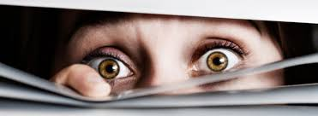
Lesson 1 - L.C. Discussing writing similar to that which they are planning to understand and learn from its structure, vocabulary and grammar (SL7E)
What is an eye-witness account?
Class task
Brainstorm the key features of an eye-witness account
An eye-witness account aims to give key information relating to an event. It discusses and answers key questions:
when?
where?
who?
how?
what? (event)

Slide 5
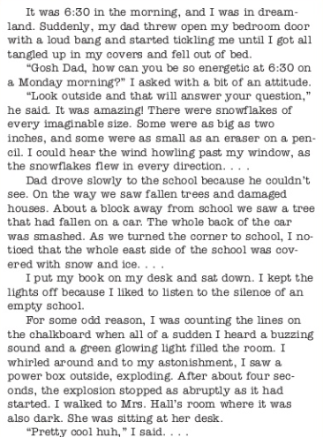
You will now consider how these questions are answered in the WAGOLL and record them on your WAGOLL.
WAGOLL
Question
How is it written? E.g. Is it formal or informal
Question
Who would be the audience of this piece of writing?
Question
What is the purpose of the text?
Question
Where would you find this text? What reading material?

Slide 6
when
where
who
Event
(what)
how

Slide 7
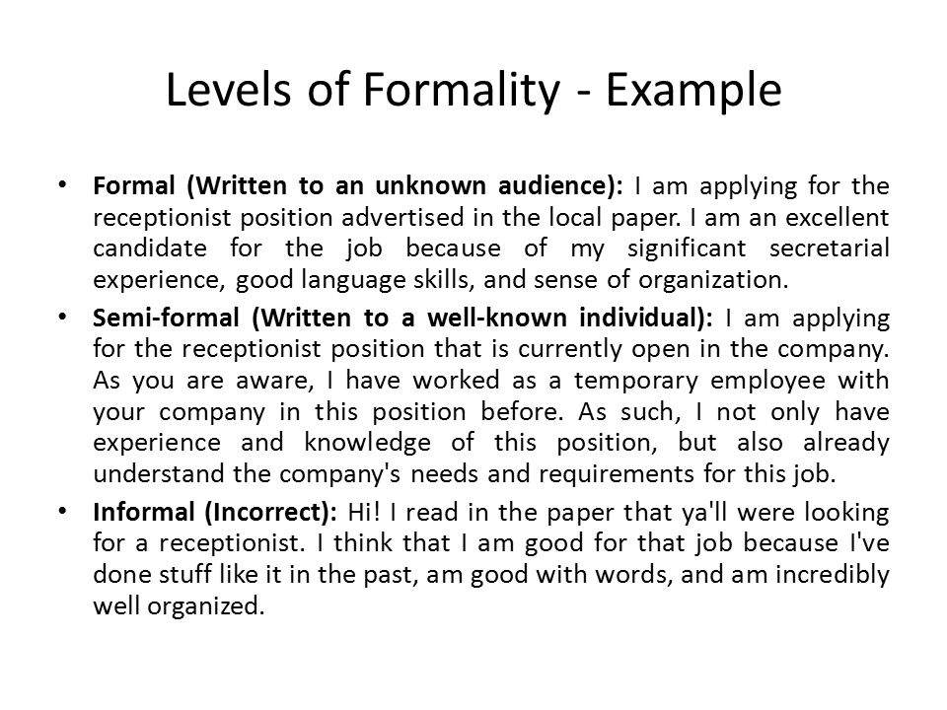
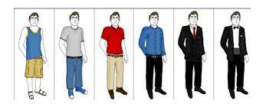
Levels of formality
Question
What level of formality is an eye-witness account?

Slide 8
Task 1
Question
Who would be the audience of this piece of writing?
Question
How is it write
n? E.g. Is it formal or informal
Question
Where would you find this text? What reading material?
Question
What is the purpose of the text?

Slide 9
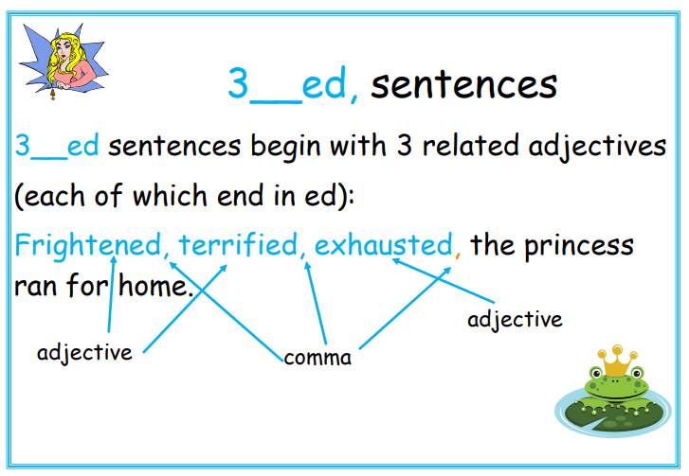
Lesson 2 – 3_ed openers (Alan Peat)
The Rule:
A 3 ed sentence begins with three related adjectives, each of which ends in ed.
The words must be followed by commas. Most ed words are used to describe emotions. They are very good for telling your reader about the character and how they are feeling.
Go back to the extract, find them and discuss their use.

Slide 10
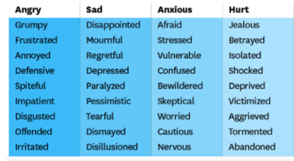

Task 1
Brainstorm ‘ed’ words as a class and categorise them into similar meanings – to show emotions. When grouping the words together, it is important that they have the same or a similar meaning in your writing to convey meaning to the information that follows.

Slide 11
Task 2
Record three sentences that start with a 3_ed opener. The sentences should be about something you have witnessed.
You must write your sentence in the context of you telling someone a piece of information about something you have witnessed. Pretend that you are telling your friend about the incident of frogs flying past your window as you ate a late night snack in the kitchen.
You must show that the three adjectives have similar meaning and demonstrate correct use of punctuation.
For example:
Captivated, alarmed, amused, I looked up to spot a shadow moving across the kitchen wall and oddly, it was in the shape of a frog!
Confused, concerned, worried, I knew this was not an every day occurrence and despite feeling very nervous, I got up to investigate.

Slide 12
Task 3
Now that you know how to group the three adjectives relating to emotions and know where to place the correct punctuation, using 3_ed sentence openers, your next task is to write a short paragraph relating to you witnessing something that has occurred in your classroom (your teacher will set up an incident!).
You are writing it from your perspective so it is important that you show your individual response to what you have witnessed – your emotions!

Slide 13
Lesson 3
In this lesson, you are going to apply the use of another style of sentence opener - position, place, subject, action.
On the next slide, is the similar adapted extract of an account where the old lady wakes up and thinks her house had been invaded by flying frogs. See if you can spot the position, place, subject, action sentence openers.

Slide 14
Adapted from Tuesday
In a house situated in the furthest region of the countryside, Mrs May opened her eyes and saw the most bizarre sight! Captivated, alarmed, amused, she knew something was wrong as she thought she had spotted frogs sat on lily pads flying out of her front room window and into the night sky. Questioning herself as to what this sight could possibly have been, she reported:
‘Whilst in the living room, I was awoken suddenly by a draft of air and droplets of water landing on my arm. Confused, concerned, worried, I knew there had to be something or someone in the house that had caused this and I looked up to spot what I thought were flying frogs. I thought I must be mistaken and rubbed my eyes, however, when I looked again, I saw the cheekiest frog wink at me, flash me a smile and zoom off out of the window and into the darkness!”

Slide 15
Lesson 3 – position, place, subject, action (Alan Peat)
position place subject action
In a house situated in furthest region of the countryside, Mrs May opened her eyes and saw the most bizarre sight!
The Rule:
This sentence type opens with a prepositional phrase which describes the position and place of the action in specific terms.
Look at where the punctuation sits.

Slide 16
Task 1 & 2
You are now going to work with a partner to ‘prove it’ and find the position, place, subject and action in the sentences on the next two slides. Draw a line to show your understanding of this sentence structure on your activity sheet. See the example below to help you set it out. You must also be able to explain to your partner the meaning of position, [place, subject and action.
Beneath the starry sky, in an abandoned church yard, a tree whistled in the gentle breeze.
position place subject action

Slide 17
Task 3
Using the image on the next slide, you will pretend that you have entered the scene and witnessed the sights before you.
In a paragraph, record your thoughts.
You must include at least one sentence that includes: position, place, subject and action.
You may also wish to include a 3_ed sentence opener to apply your learning from yesterday’s lesson.

Slide 18
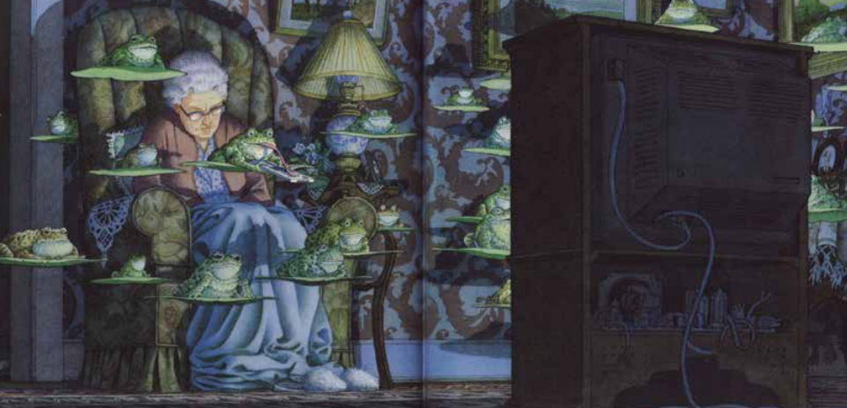
Task 3 Continued- Imagine you are Mrs May

Slide 19
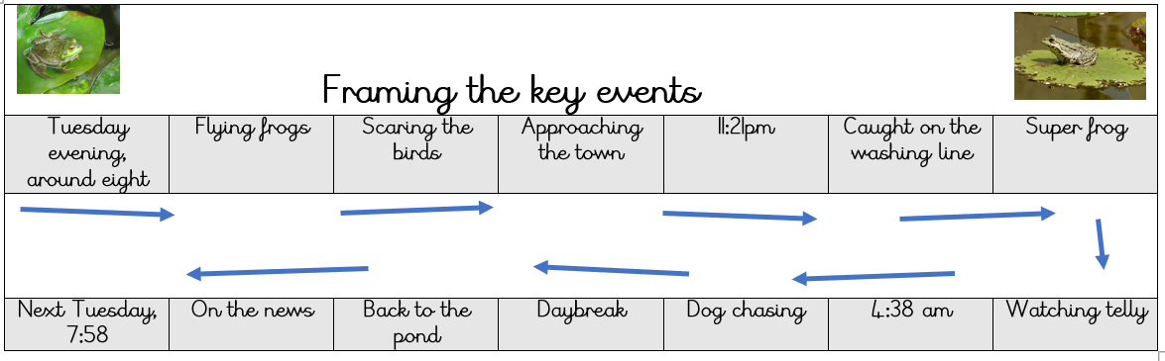
Lesson 4 – Creating a timeline of events
For this lesson, we are going to map out a timeline of the events of Tuesday night.
We will bullet point the various key events and write a brief description about each event.
This visual timeline takes us through the story
These are the points that you need to be familiar with in your role as an expert witness

Slide 20
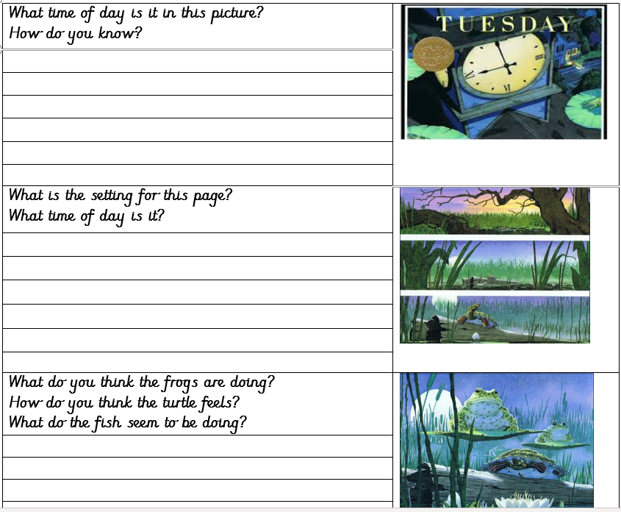
Todays task
Using the written timeline, make brief notes in each section to explain what happened.
Additional note: for our sentence stacker lessons, we will be writing witness accounts for the following key events
Approaching the town
11:21
Dog chasing
This means that today, you can decide in advance which key event in the story you will be an expert witness for.
Will you be Mrs May?
Will you be the detective at the end of the story?
Will you be a resident out walking your pet dog?

Slide 21
Sentence stacker Lesson 5 – Key event – Approaching the town
Witness account from Miss Lovely, driving home from work.
Writing features we will cover
Embedded clauses
3-ed sentences
Fronted/time adverbials

Slide 22
Sentence 1- embedded clauses
What is an embedded clause in a sentence?
An embedded clause is a clause used in the middle of another clause to give the reader more information about a sentence.
Embedded clauses rely on the main clause and don't make sense in isolation.
We separate embedded clauses from the main sentence with punctuation on either side of the clause

Slide 23
Spot the embedded clause
The staff cark park, which we had to pay to park on, had a faulty barrier which meant I had to stay even longer at work.
Driving the distance home, which seemed to take forever, helped me to wind down after my busy shift.
TTYP and find the main clause. Prove why it is the main clause and not the embedded clause. Explain your reasons in your ideas box.

Slide 24
Sentence 1 -
Our class model
Deepen the moment: Could you describe the traffic on the roads or any other sights that Miss Lovely may have passed on her way home?
Notes:
After finishing a busy shift in the local hospital, which had lasted 20 minutes longer than it should have done, I was driving home singing to the radio. Tired, drained and overworked, I remember glancing at my clock, and it was 8:15 which meant I had 15 minutes to get home in time to watch Great British Bake Off.

Slide 25
Sentence 2 – 3_ed sentences
Remind me about this Alan Peat skill that we covered in the previous lesson. TTYP and then share

Slide 26
TTYP
Using your inference skills, how do you think Miss Lovely would be feeling as she drove home after a long shift at the hospital. Remember that the shift lasted longer than it should have done.
What ed words would be effective to describe how she may have been feeling?
Jot these down in your second ideas box

Slide 27
Sentence 2 -
Our class model
Deepen the moment: Can you describe something that Miss Lovely may have been looking forward to once she got home?
Notes:
Tired, drained and overworked, I remember glancing at my clock, and it was 8:15 which meant I had 15 minutes to get home in time to watch Great British Bake Off.

Slide 28
Sentence 3 Fronted/Time adverbial
Fronted adverbials
A fronted adverbial is when the adverbial word or phrase is moved to the front of the sentence, before the verb.
"Earlier today, I discovered fronted adverbials."
So here, 'earlier today' is a fronted adverbial.

Slide 29
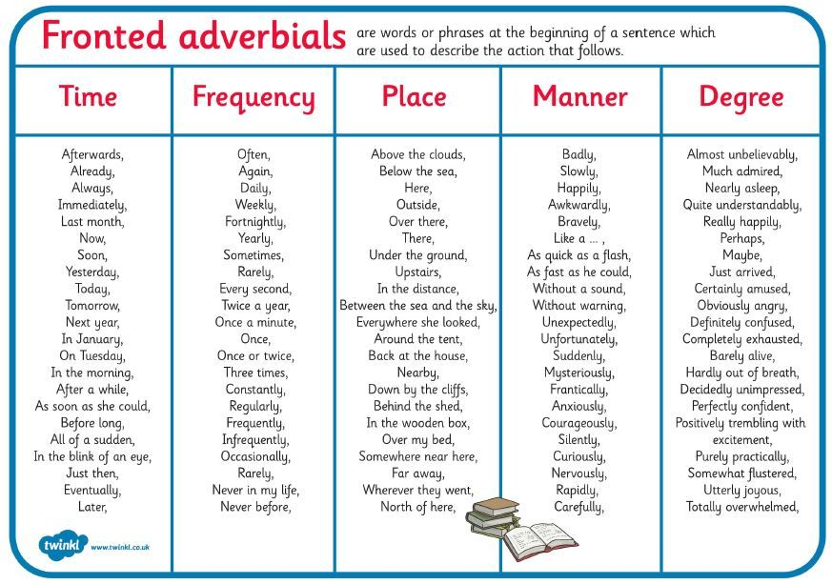
Make a note in your third ideas box of fronted adverbials that could be used for this genre of writing. Remember the time of the day that this was witnessed.

Slide 30
Sentence 3 -
Our class model
Deepen the moment: How did Miss Lovely start to feel at this point?
Notes:
Suddenly, I happened to notice that even though it was already dusk, it rapidly got a lot darker and the small amount of light that had been illuminating the car, faded fast.

Slide 31
Sentence stacker Lesson 6 – Key event – 11:21 pm
Witness account from Miss Lovely, Mr Brown, eating a snack in his kitchen
Writing features we will cover
Speech and correct punctuation
Brackets for additional information
SP3 The suffix –ous

Slide 32
Lesson 6 – Sentence stacker 1 – Speech
Punctuation: Introduction to speech marks (KS2) – YouTube
Watch the clip above about using and punctuating speech marks

Slide 33
When you are writing, inverted commas (also called speech marks) go before and after any words that a character says.
For example: "I'm hungry," complained Goldilocks.
‘I’m hungry’ are the words that Goldilocks says out loud (also called direct speech), so the inverted commas go at the start and end of those words.
If another character replies, the rule is to:
use another set of inverted commas
put the new person speaking on a new line
For example:
"There’s some porridge on the stove,” said her mum.
"But I've already had some porridge today!” exclaimed Goldilocks.
Any punctuation goes inside the inverted commas at the end of what the character is saying.

Slide 34
Your turn to try
Here is what an eye witness saw on Tuesday night.
Your job is to write the sentence in your ideas box and punctuate it correctly.
I thought I was dreaming. I looked outside and had to rub my eyes and look again. I couldn’t even find the words to describe what I had seen!

Slide 35
Sentence 1 -
Our class model
Deepen the moment:
Notes:
“I think I am still in shock! I can’t really explain what happened!” exclaimed Mr Brown as he rushed out to speak to our reporter.

Slide 36
Sentence stacker 2 – using brackets for additional information
Using brackets is something that you will become more familiar with in Y5 and Y6.
We are going to try using brackets today because you are very confided using embedded clauses, and using brackets is a similar skill.

Slide 37
What are brackets?
Brackets are a handy punctuation mark that can be used to add extra information to a sentence. If you decided to remove them from the sentence, the overall meaning of the sentence wouldn't change.
Adding brackets can make a sentence just a little bit more interesting thanks to the extra detail.
An example would be:
My Grandad Albert (who had forgotten his glasses) was in charge of reading the map.

Slide 38
Brackets
Without brackets: Albert the alien was in charge of the wrecking ball.
With brackets: Albert the alien (who had no training) was in charge of the wrecking ball.
The sentence has to make sense without the words inside the brackets, it's just a bit more interesting with the added detail.

Slide 39
You try
Here are some sentences taken from the statements of eye witnesses.
The frogs appeared to be wide awake as they flew passed me.
The sky was dark by I know what I saw.
Your task is to make changes to both sentences and include brackets in each one.
Write the new sentences in your second ideas box.

Slide 40
Sentence 2 -
Our class model
Notes:
Mr Brown claims he has spotted frogs (flying on lily pads past his kitchen window) while he was eating a snack late last night.

Slide 41
Sentence stacker 3 – using the suffix –ous
Suffixes
A suffix is a letter or group of letters that goes on the end of a word and changes the word's meaning.
Sometimes they also change the original word's spelling. When adding a suffix you might have to double the last letter. For example when adding 'ed' to 'drop' you also double the p so it becomes 'dropped'.
Some suffixes have specific uses. Adding ‘ing’ can change a noun into a verb eg 'garden' to 'gardening'. While ‘ed’ can put a verb in the past tense eg 'jump' to 'jumped'.

Slide 42
Suffix –ous
Today we are going to focus on words with the suffix –ous
The suffix –ous means ‘full of’
When we add –ous to a noun it turns it into an adjective.

Slide 43
Word | Sentence
Poisonous | We don’t even know if the frogs are poisonous!
Dangerous | How do we know if these creatures are deadly and dangerous?
Famous | Since this news went live, our quiet town has become very famous!
Tremendous | Initially, I had tremendous doubt over what I thought I had seen.
Enormous | The flock of flying frogs was enormous, you really had to see it to believe it!
Jealous | My sister is very jealous that she didn’t get to see such a mystery!
Serious | I really hope the detectives are taking these reports very serious as I know exactly what I saw!
Have a read through of these
–ous words and the sentences to go with them.
Choose 3 and write your own sentence linked to the story.
Chilli Challenge: try to also include brackets in your sentences.

Slide 44
Sentence 3 -
Our class model
Notes:
He was desperately trying to warn people to be cautious, curious but above all else, to take this sighting very serious! Many people have responded to these claims as humorous and ridiculous.

Slide 45
Sentence stacker Lesson 7 – Key event – Dog chasing
The key features we are going to cover include;
Expanded noun phrases
Adverbials of time
The suffix –sion

Slide 46
Sentence stacker 1- Expanded noun phrases
Remind me what an expanded noun phrase is?
Is this sentence an expanded noun phrase?
Within minutes, the pond began to bubble.
Prove it in your first ideas box
Re-write it with your best attempt at making it an expanded noun phrase.

Slide 47
Sentence 1 -
Our class model
Notes:
It must have been almost midnight and I was about to go up the stairs to bed, however, I realised I still needed to put out the rotten, stinky bins ready for the morning.

Slide 48
Sentence stacker 2-Adverbials of time
Secret vote.
Look at these 4 choices and decide which one isn’t a time adverbial.
Put your heads on the desk and vote.
In that moment B) Quickly and carefully
C) After a while D) Without warning

Slide 49
Which wasn’t an adverb of time?
If you said they are all time adverbials, they you are correct, well done!
In your second ideas box, jot down some suitable time adverbials that we could use to talk about the events from the night before.
Share our ideas and magpie any good ones.

Slide 50
Sentence 2 -
Our class model
Notes:
As quick as a flash, Bruno (the dog from next door) flew passed my front garden making the strangest howling noise!

Slide 51
Sentence stacker 3- The suffix –sion
The 'shun' sound at the end of a word is often spelt -sion.
Look out for words that are spelt with 'sion' at the end.
Invasion
Division
Confusion
Television
Can you think of any more?

Slide 52
Spelling task!
Look at these words below.
Some are spelled incorrectly.
You need to identify them and spell them correctly in your third ideas box.
Aggresshun
Conclusion
Obsesshun
Televishun
Revision

Slide 53
Sentence 3 -
Our class model
Notes:
I looked over in the direction he came from and I am absolutely certain I spotted an alien invasion!

Slide 54
Lesson 8 – Writing your expert witness account
Look back at the timeline of events. You can choose where you were on Tuesday night (the night of the flying frogs).
You will write an expert witness account of what you saw, in a similar style to the witness accounts we have written in our sentence stacker lessons.
Start by planning these aspects ready for your account;

Slide 55
Choose where you were and jot down the answers to these questions.
An eye-witness account aims to give key information relating to an event. It discusses and answers key questions:
when?
where?
who?
how?
what? (Flying frogs)

Slide 56
Where did you witness something in the timeline of events?

Slide 57
Features to include
Embedded clauses
3-ed sentences
Fronted/time adverbials
Speech and correct punctuation
Brackets for additional information
SP3 The suffix –ous
Expanded noun phrases
Adverbials of time
The suffix –sion

Slide 58
Lesson 9 – Complete and edit

Slide 59
Sentence stacker WAGOLL for Miss Lovely – Approaching the town
After finishing a busy shift in the local hospital, I was driving home singing to the radio. Tired, drained and overworked, I remember glancing at my clock, and it was 8:15 which meant I had 15 minutes to get home in time to watch Great British Bake Off.
Suddenly, I happened to notice that even though it was already dusk, it rapidly got a lot darker and the small amount of light that had been illuminating the car, faded fast.
Curiously, I looked up and let my eyes adjust to the sight. Initially I assumed I was confused, and I did a double take. Startled, panicked, alarmed, I hit the breaks on my car with great gusto and brought it to a halt. In that moment, just two words left my mouth: Flying frogs!
Mr Brown
“I think I am still in shock! I can’t really explain what happened!” exclaimed Mr Brown as he rushed out to speak to our reporter.
Mr Brown claims he has spotted frogs (flying on lily pads past his kitchen window) while he was eating a snack late last night.
He was desperately trying to warn people to be cautious, curious but above all else, to take this sighting very serious! Many people have responded to these claims as humorous and ridiculous.
Dog Chasing
It must have been almost midnight and I was about to go up the stairs to bed, however, I realised I still needed to put out the rotten, stinky bins ready for the morning.
As quick as a flash, Bruno (the dog from next door) flew passed my front garden making the strangest howling noise!
I looked over in the direction he came from, and I am absolutely certain I spotted an alien invasion!

